Slide 1

Fast Quantum Byzantine Agreement
High Performance Computing assignment
Andrea Adorni, Giovanni Schianchi

Slide 2

Byzantine Agreement
Common decision among all
Presence of cheating peers
Agreement
Validity
Termination

Slide 3

Fast Quantum Byzantine Agreement
Quantum alternative
1 round
Protection against cheaters up to n/3
Used to improve the security and speed of the agreement

Slide 4

QOCC
Subroutine when there isn’t an agreement
When sum of bits is between n/3 and 2n/3
Every peer returns a bit with a certain probability
VQSS encoding to defend from malicious peer (Reed-Solomon)

Slide 5

Algorithm
Composed by three routines
Every peer sends and receive bits from other
Calculate the sum of bits and checks it
In base to sum sets the bit to 0 or 1

Slide 6
Algorithm
First routine:
Decides direction of execution
If indecision -> Quantum subroutine
Second and third routine:
Boost of bias into 1 or 0 output
Return or start another round

Slide 7
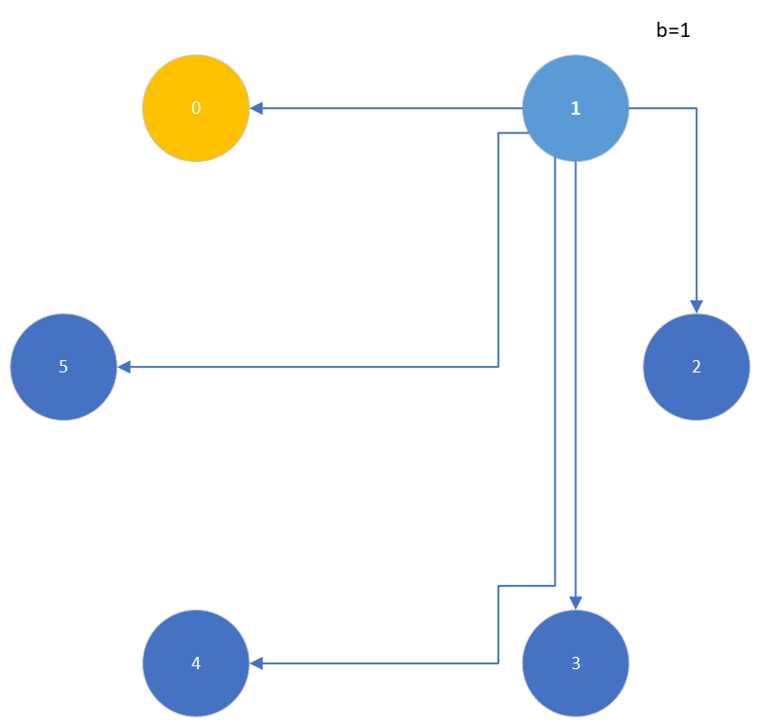
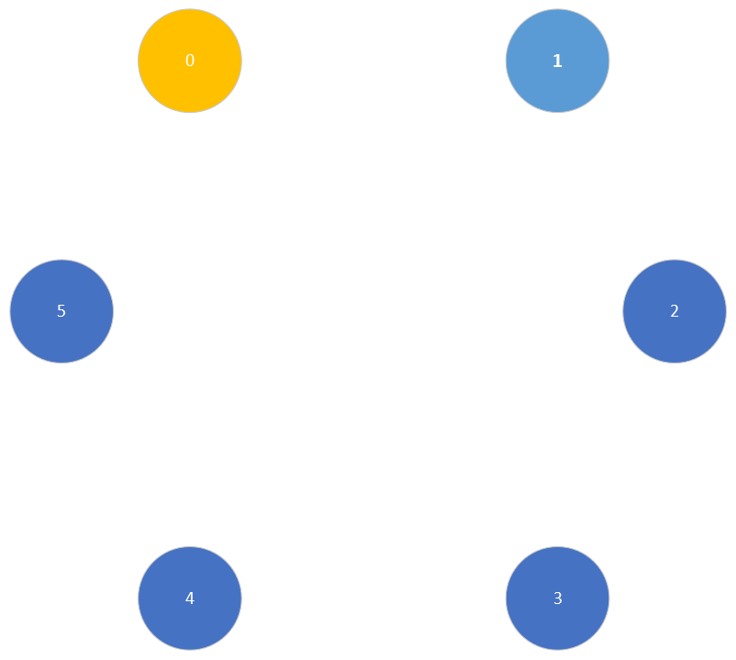

Slide 8
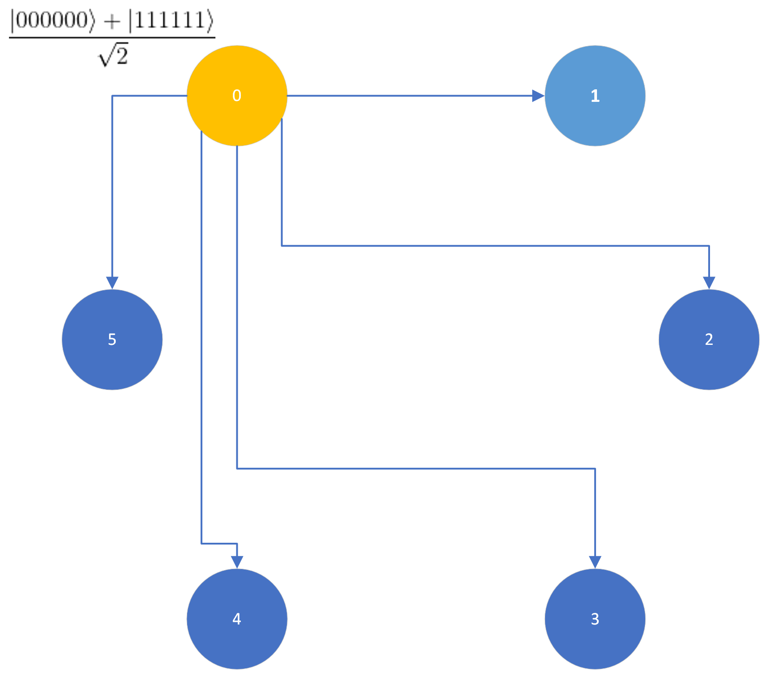
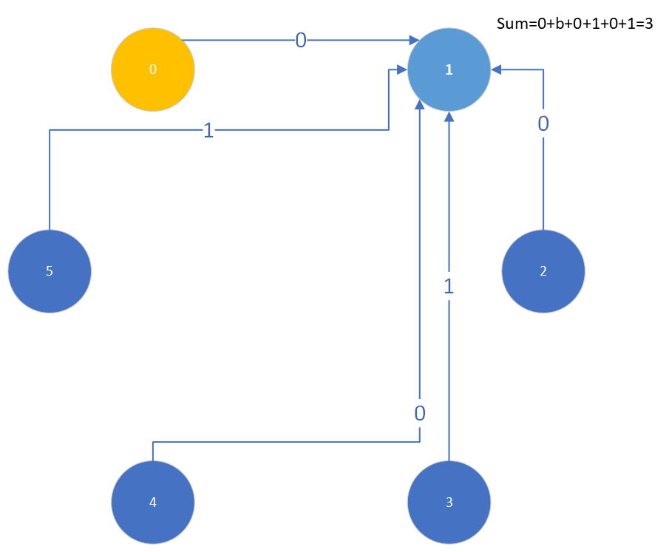
Quantum subroutine

Slide 9
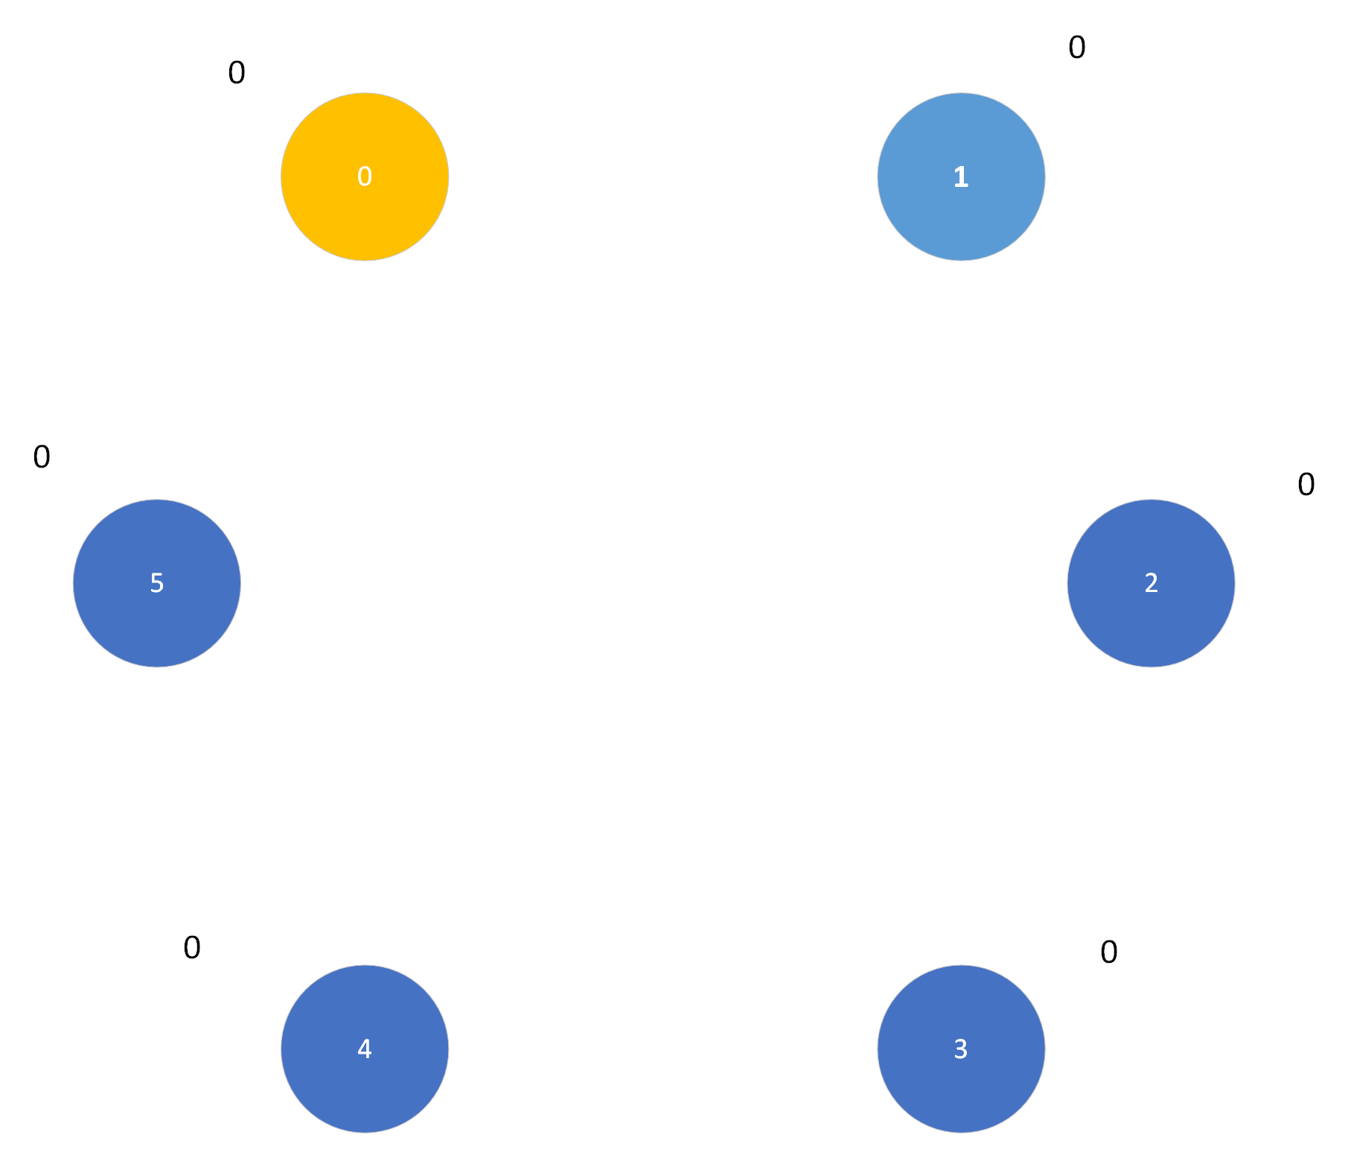
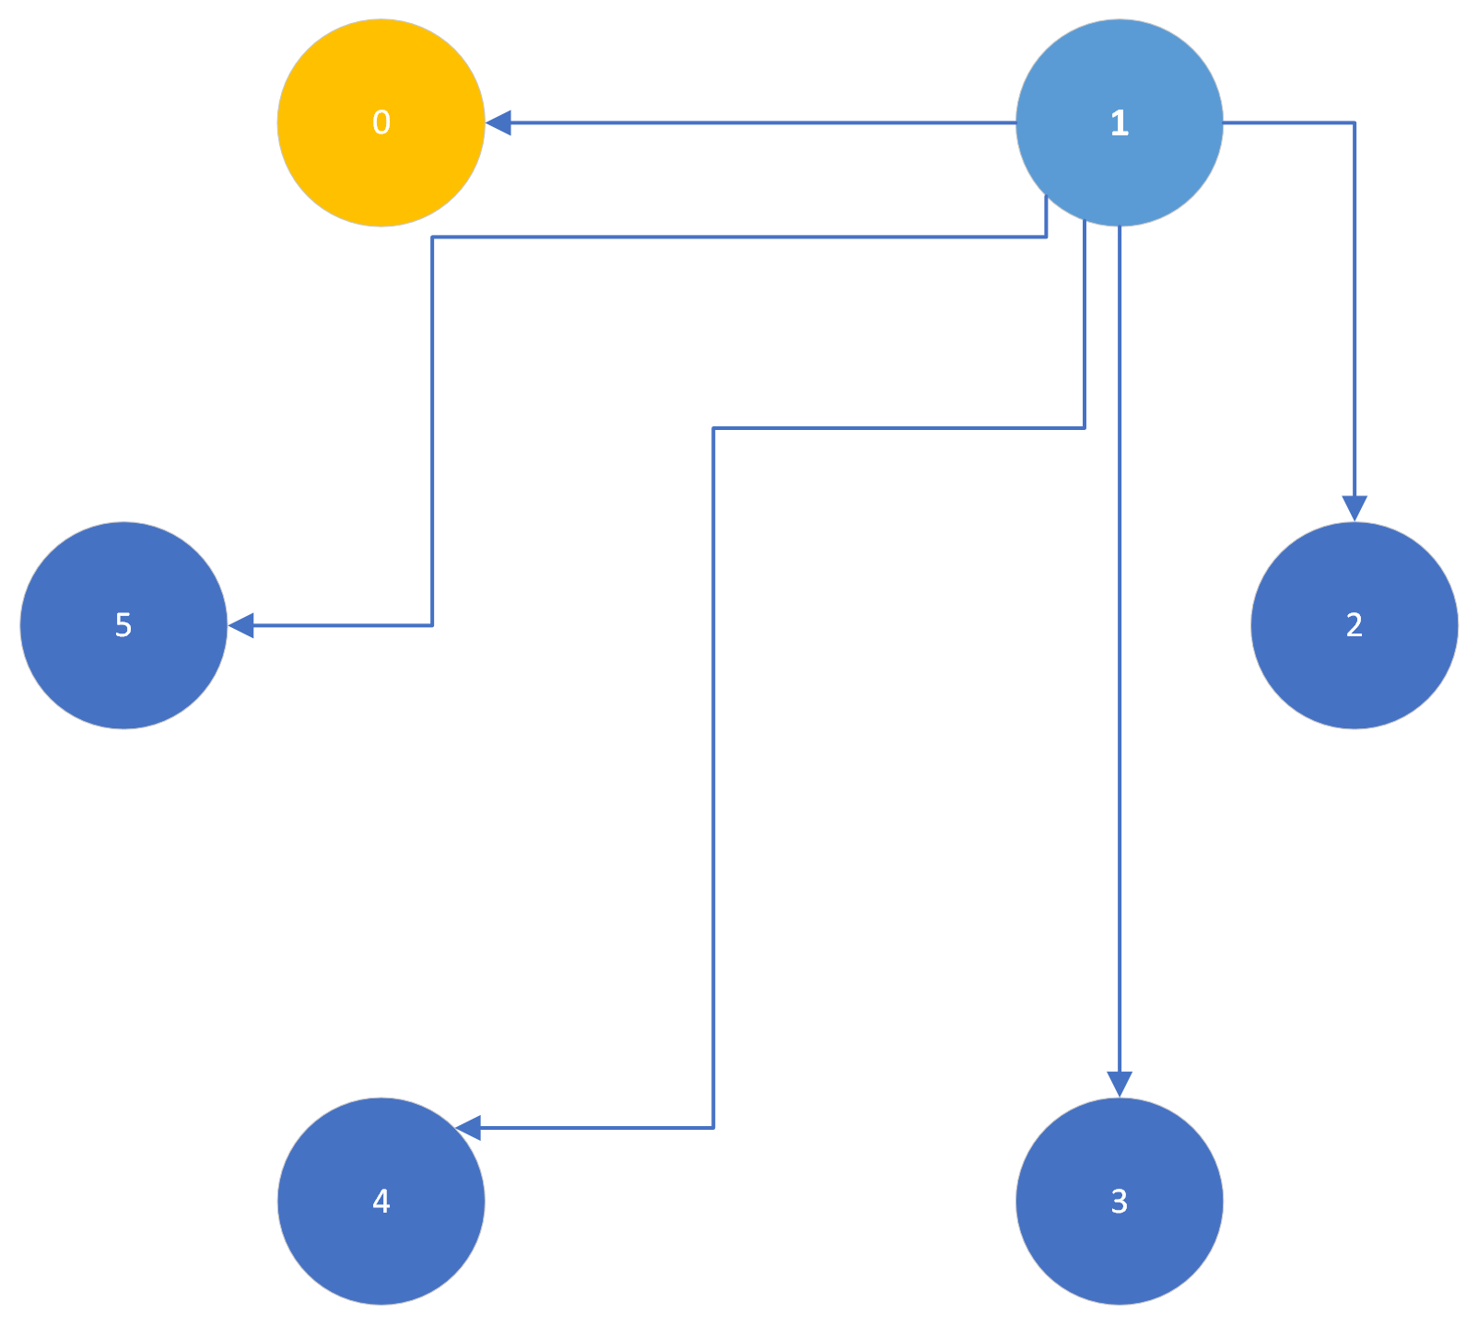

Slide 10
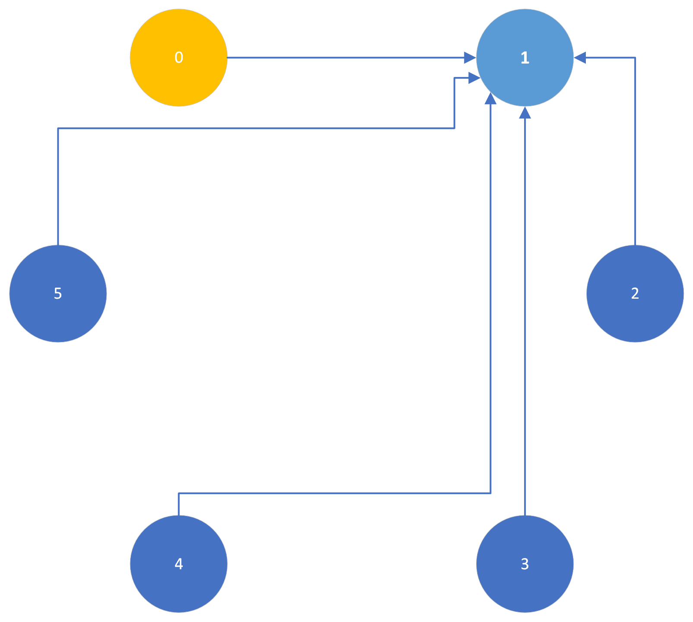
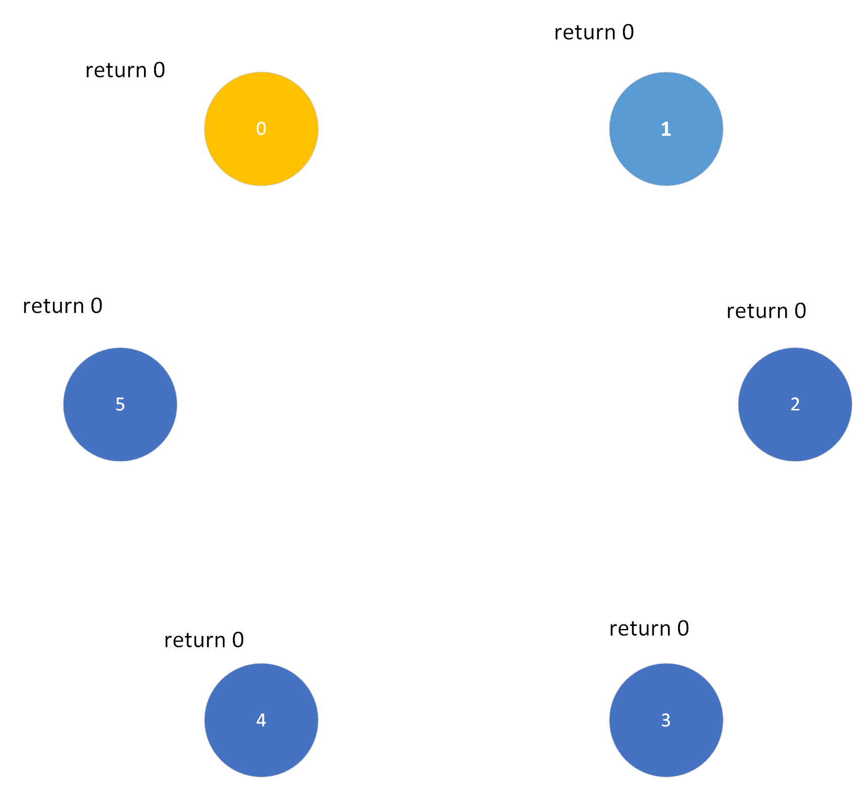

Slide 11

Implementation
NetQASM to make quantum network applications
Python
SquidASM to simulate application
Single config file generates all nodes
Alternative to QOCC for noise study

Slide 12
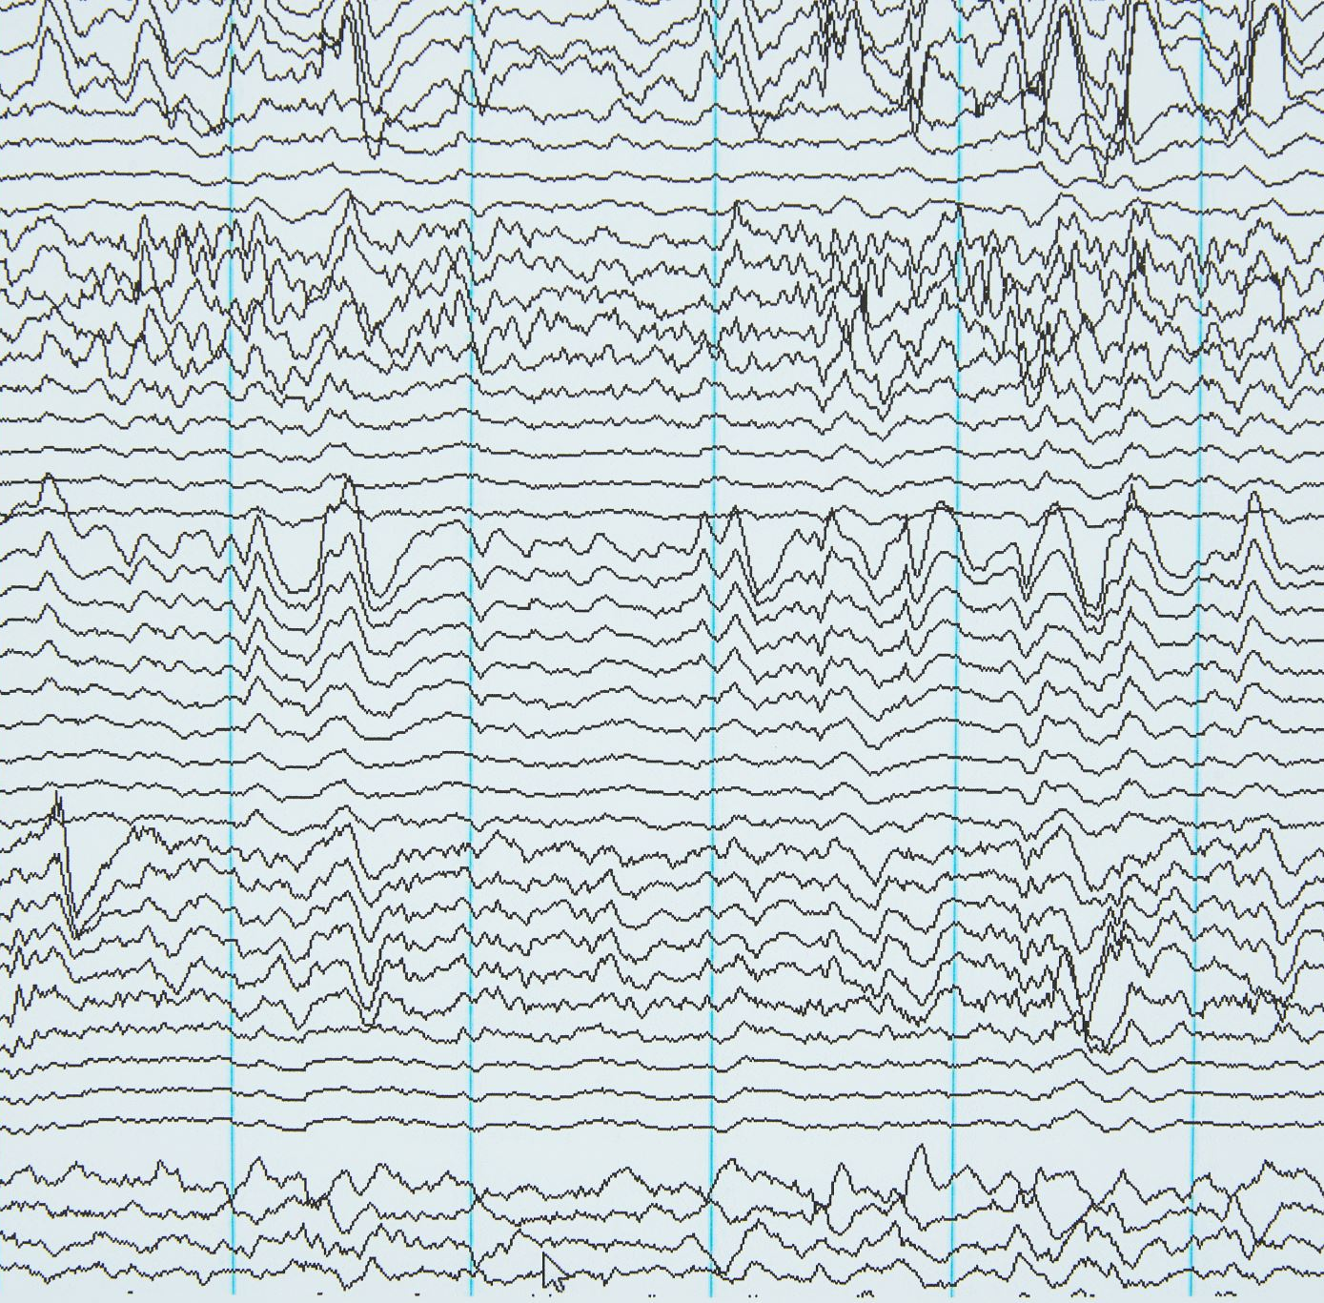
Results Parameters :
Gate fidelity and fidelity
Type noise
Decoherence times
Number of peers
30 runs for every test case

Slide 13
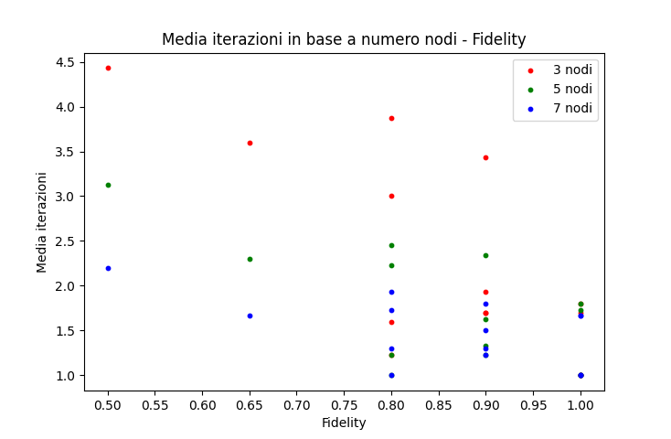
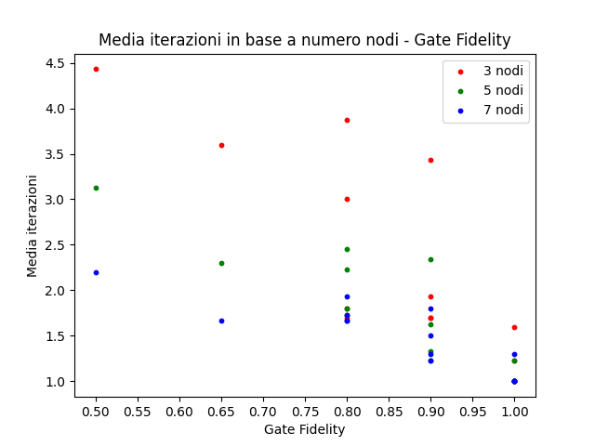
Results

Slide 14

Conclusions
In the ideal case, the number of iterations is equal to 1
More noise more iterations
High number of peers ensure greater robustness to noise

